Slide 1

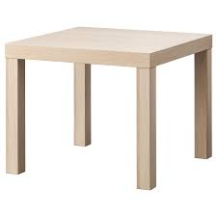
Stable Table
ECE 196 Spring 2024
By Katelyn Okano, David Salzmann, Rebecca Wong
Problem
Test Results
Design
Text: much words
Title
information :)
different text
hi
i just don’t
delete and re figure size later
want to
Prototype
Hypothesis
probably more text and images
Proposed Tutorial
more words
more text
https://sites.google.com/ucsd.edu/ece-196-project-website-team10/home (will reformat)
mmmm yes text

